Slide 1


Analyzing what affects the number of cab rides in a given 2 year period to decide which company to invest in.

Slide 2
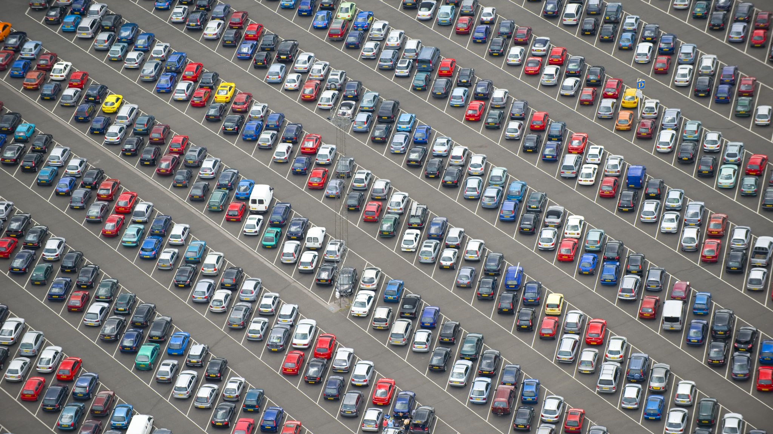
Motivation
XYZ is a private firm in US.
Due to remarkable growth in the Cab Industry in last few years and multiple key players in the market, it is planning for an investment in Cab industry.
As per their Go-to-Market(G2M) strategy they want to understand the market.
I have been provided with multiple data sets that contains information on 2 cab companies.
XYZ is interested in using your actionable insights to help them identify the right company to make their investment.

Slide 3

Key insights

Slide 4
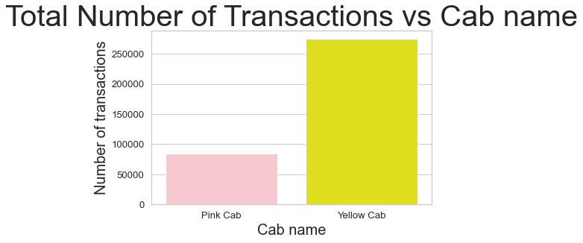
Yellow cab have a lot more rides than pink cab
Total transactions

Slide 5
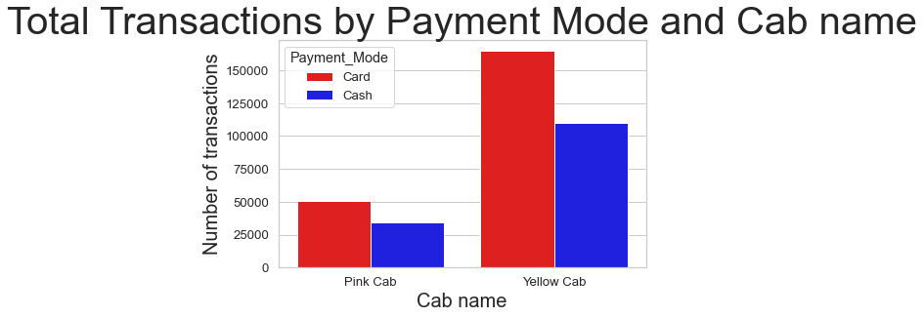
More people pay with card at both companies. A larger share of yellow cab customers pay with card than pink cab.
Transactions by payment method

Slide 6
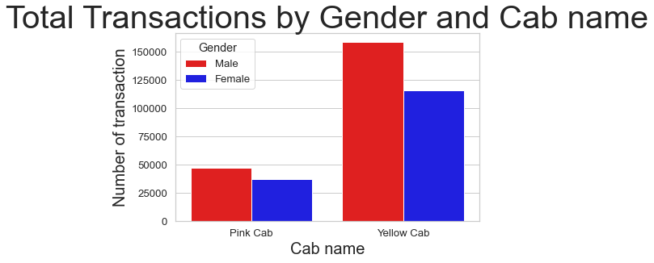
More men use taxi services than women. The difference is significantly more with yellow cab as compared to pink cab.
Transactions by gender

Slide 7
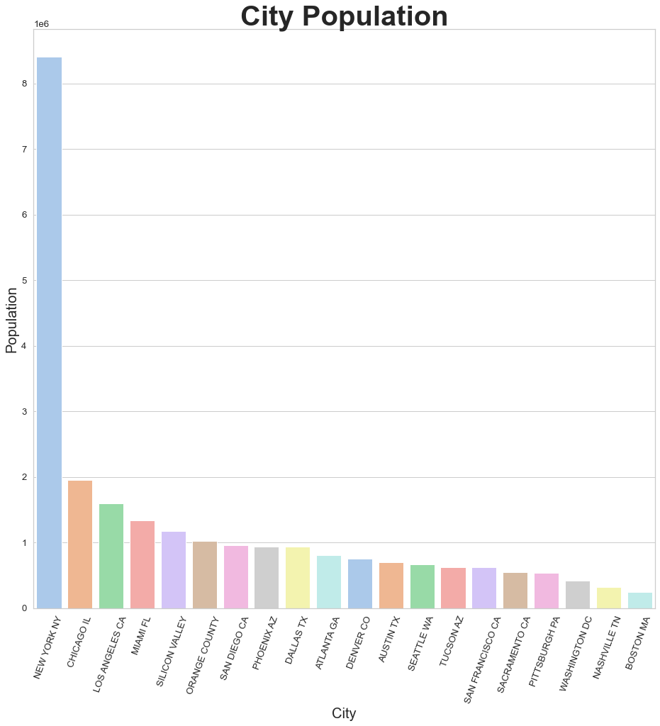
Transactions by city
New York City has the highest population followed by Chicago and LA with Nashville and Boston having the lowest.

Slide 8
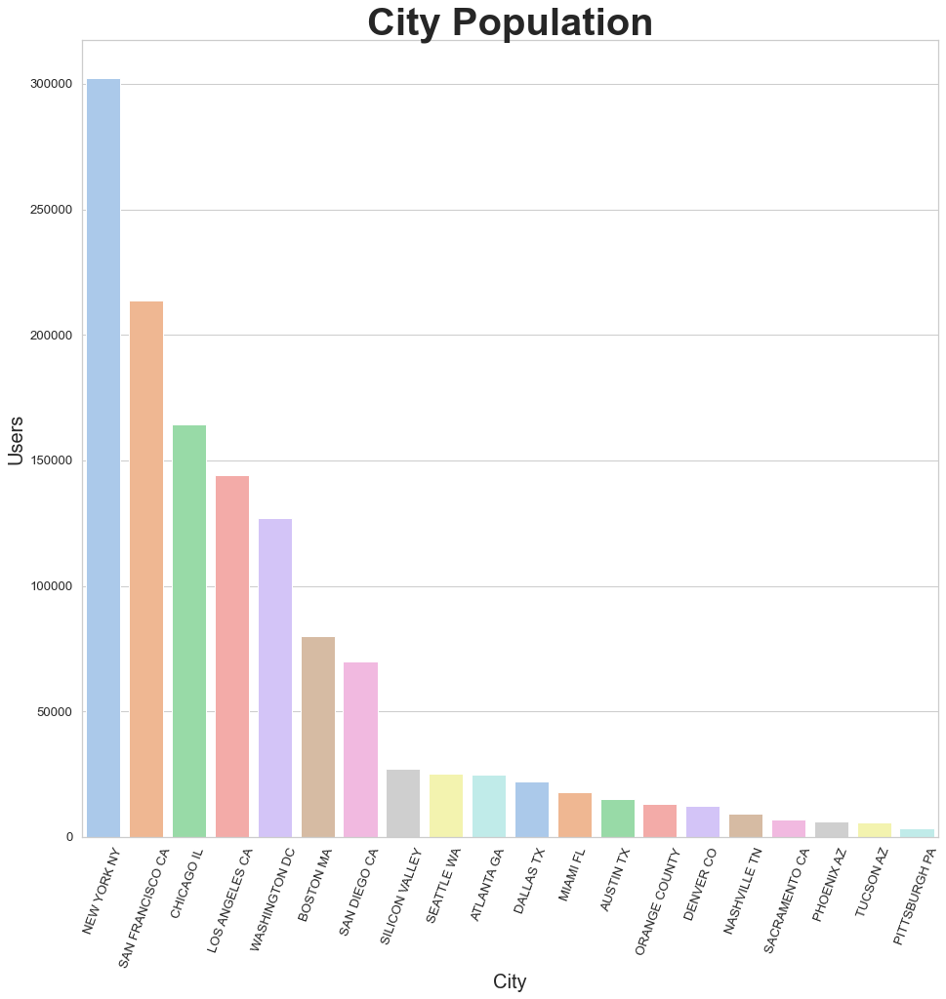
Users by city
New York City has the highest number of taxi users still but closely followed by San Francisco.

Slide 9
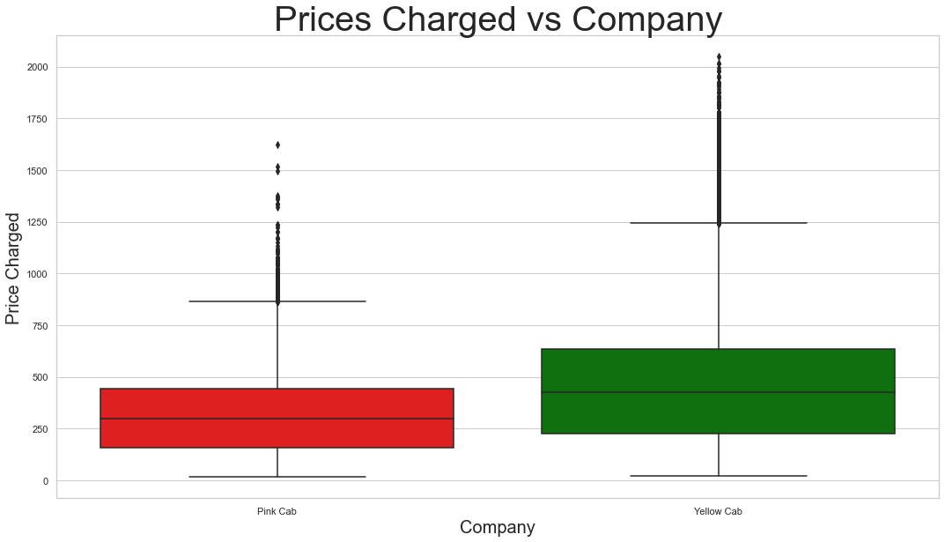
Prices charged by company
Yellow cab generally charges more and has a higher variance in prices also.

Slide 10
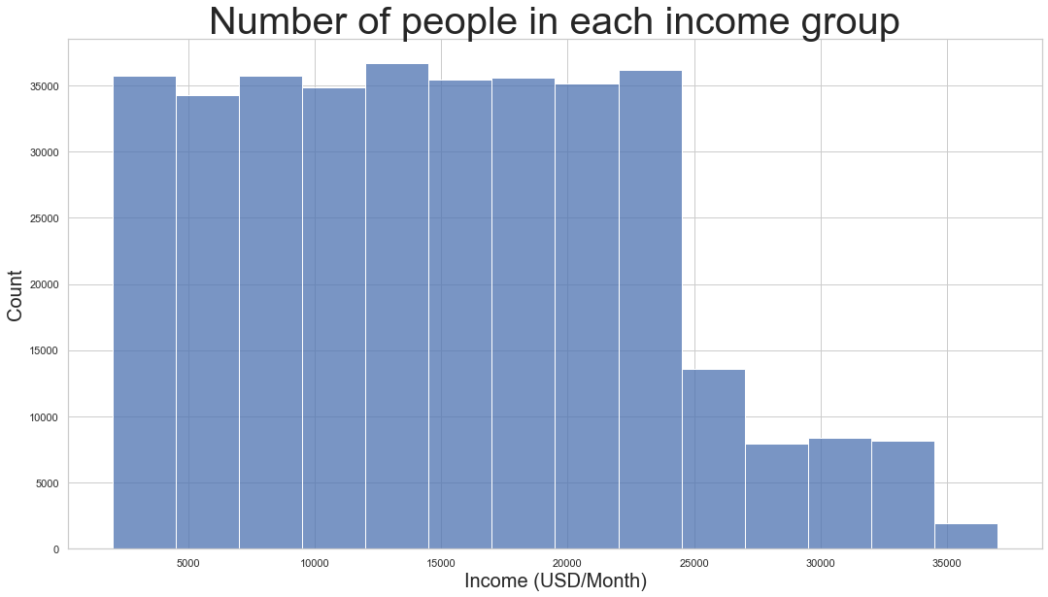
Number of people in each income group
There are around 35000 people in each income category from $2500-$5000 per month to $22500-$25000 per month after which there is a steep decline.

Slide 11
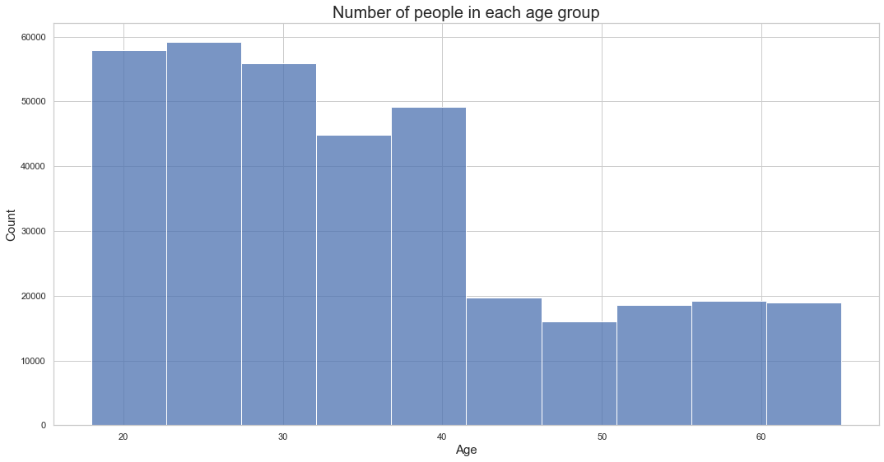
Number of people in each age group
People under 40(and especially under 30) use taxis a lot more than older people. 24-30 is the most common age of taxi usage.

Slide 12
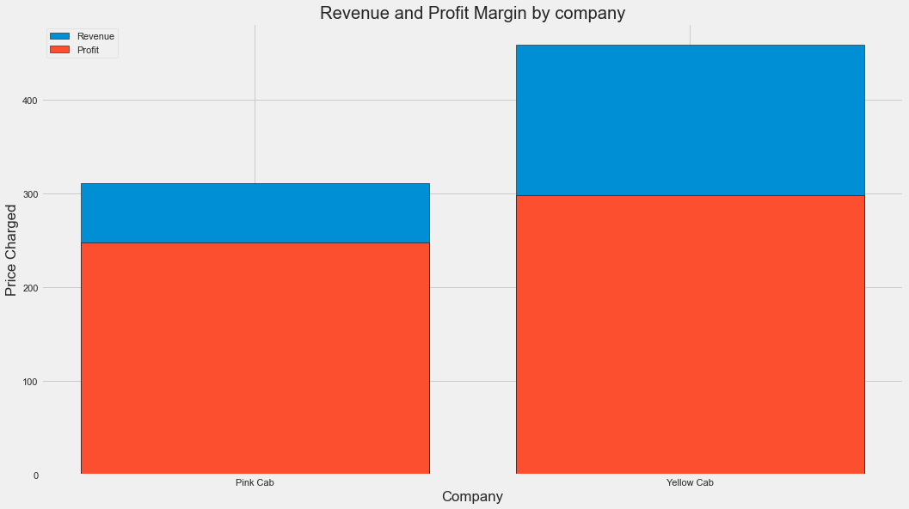
Revenue and profit margin by company
Yellow cab charges more and has a higher percent markup than pink cab.

Slide 13
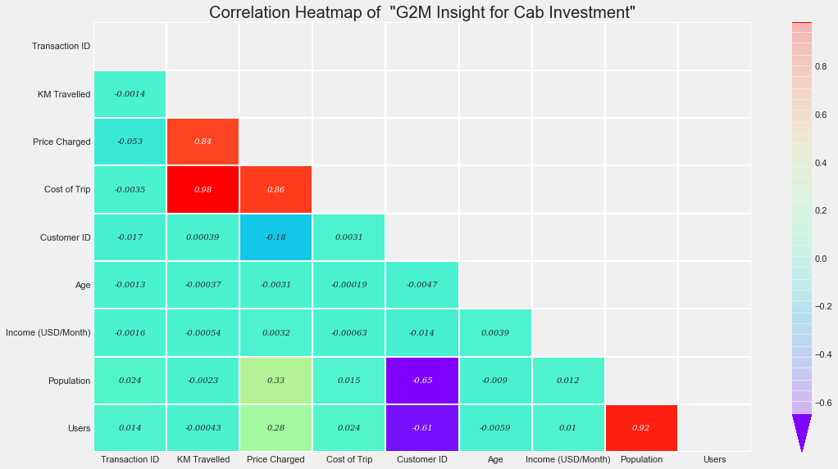
Correlation between multiple variables
Insights from figure:-
1) The more people in a city, the more taxi users.
2) The further you travel, the more the trip costs and thus the more you pay.
3) If the trip costs more, you pay more.

Slide 14
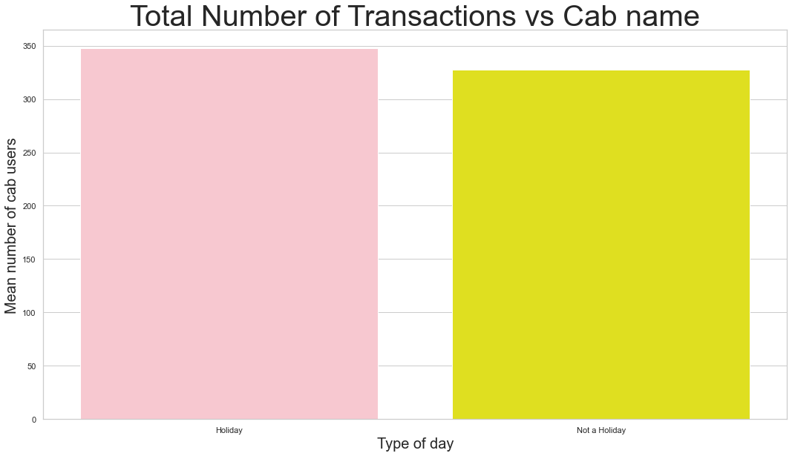
Revenue and profit margin by company
There are slightly more taxi rides on holidays than workdays.

Slide 15

Thank you

